Slide 1
OUBer
Human Computer Interaction
Group 7
2019

Slide 2
Members of Group 7

Slide 3
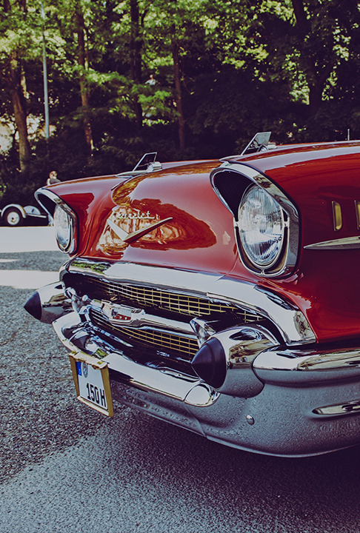
Summary
College students have issue with lacking transportations to go outside of campus
Made an app can help with us
Find other students with cars offering
List details such as destination, time and payment
Avoid to interactions with completed strangers
Make money let everyone happy!

Slide 4
Overall Process
Step 1
Step 2
Step 3
Step 4
Step 5
Step 6
Idea discussion
Tasks separations
Draw the app
Made searching questions
Distributing designed questions
Collecting answers
Prototype
Data analysis
Programming
Debugging
Testing
Final Report

Slide 5
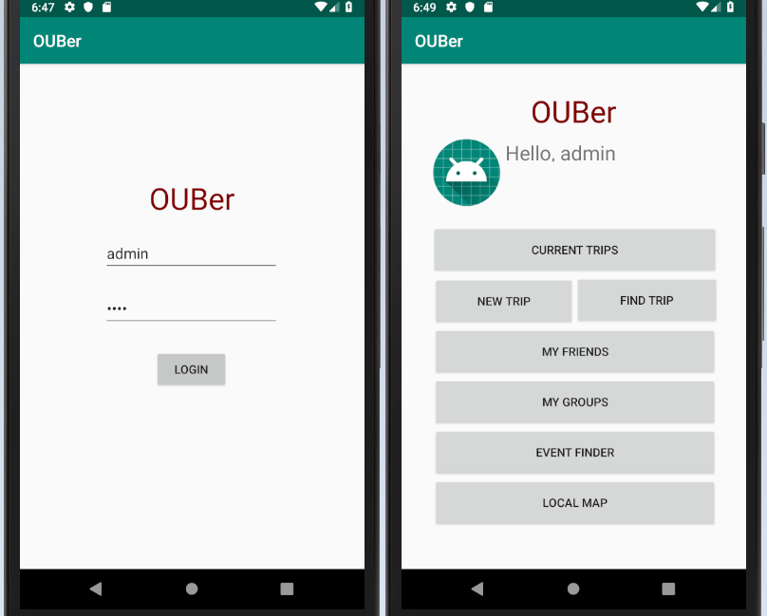
How the app runs
Login and Main Menu

Slide 6
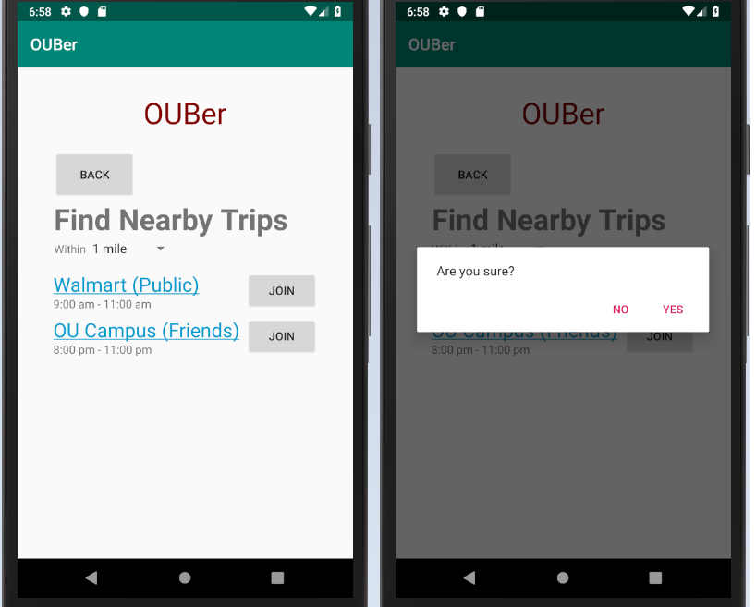
How the app runs
Find and Join nearby trips

Slide 7
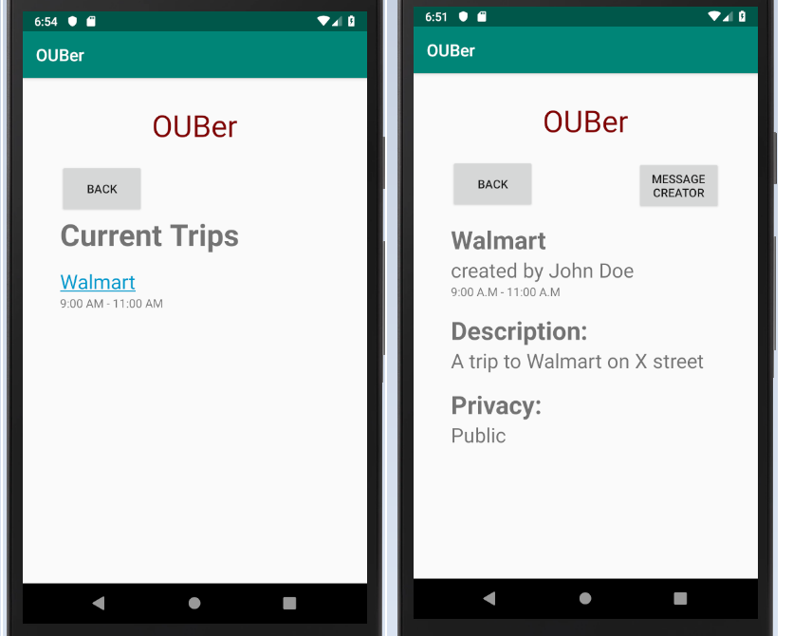
How the app runs
Current Trips and Its details

Slide 8
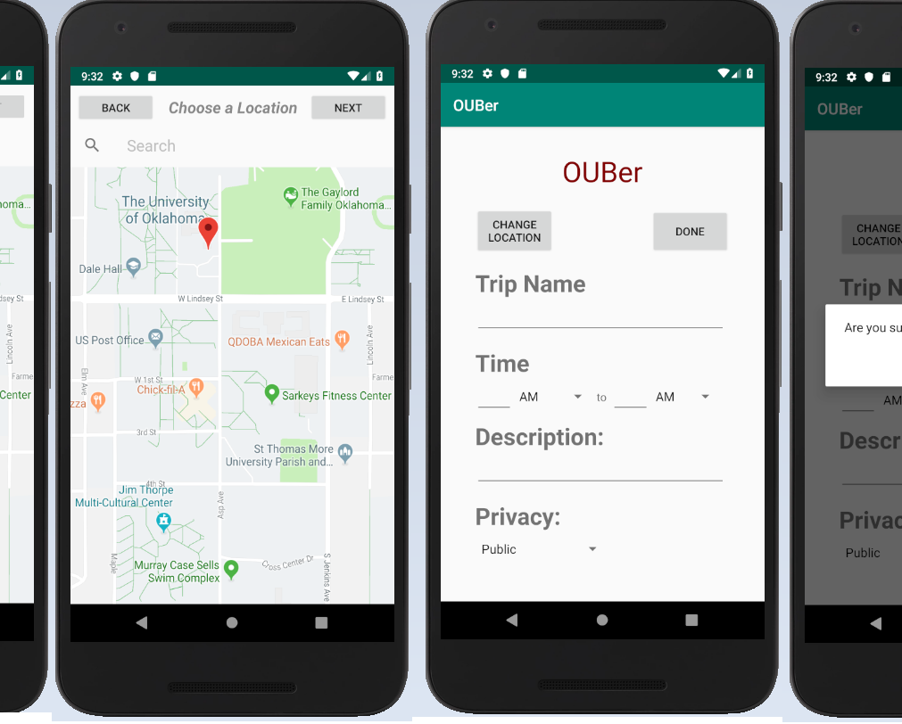
How the app runs
Creating new Trip

Slide 9
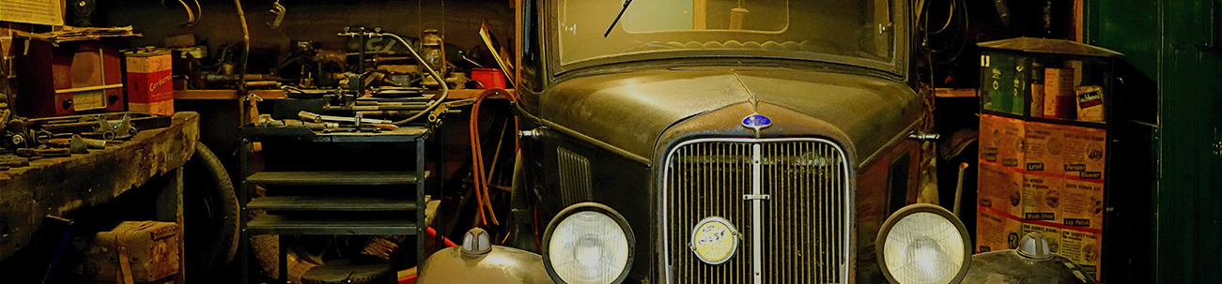
Accomplishments
Login with ID
Finding cars around you
Showing the details of trip
Mapping, finding, and more…

Slide 10

Planned to do more…
Make a group
Add friends
Chat system
…

Slide 11
Future
Developing
Operating
Add group functions
Add friend functions
Add chat system
Provide different languages
Better design UI
OU campus
To different campus
Invest into society
Invest into the whole country
Provide International version

Slide 12
Thank You!
Hoa Hoang, Xinyu Hu, Amy Le, Kichang Song, Ethan Vong
Human Computer Interactions
Team 07
The University of Oklahoma
2019

